Slide 1
NPTEL-MOOCs TA Training
Centre for Educational Technology
IIT Guwahati

Slide 2
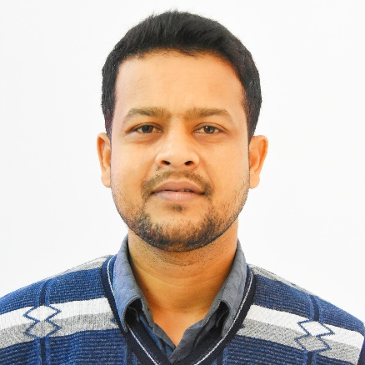




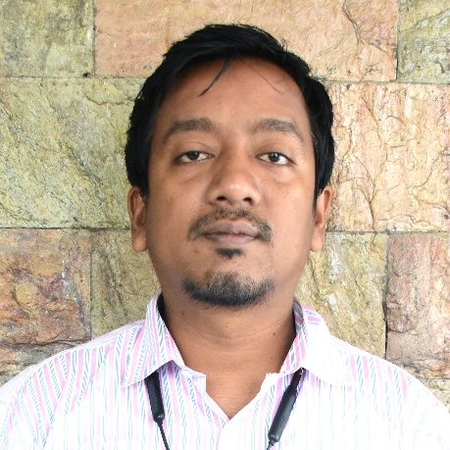
Team
Dibyajyoti Lahkar
Bikash Jyoti Nath
Queen Barman
Rekha Hazarika
Kaushik Kr. Sarma
Pranab Rajbongshi

Slide 3
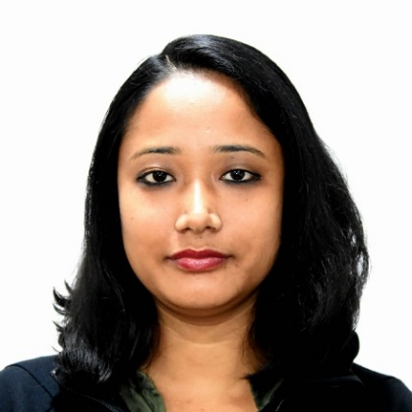




Recording Team
Alilakshi Borgohain
Mriganka Borah
Sanjib Phukan
Anamika Deka
Heramba Das

Slide 4
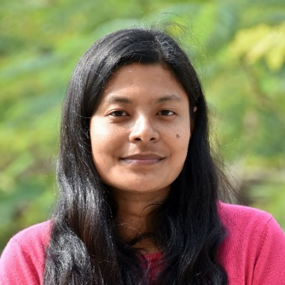

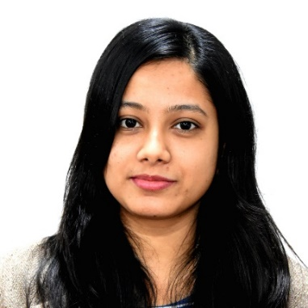

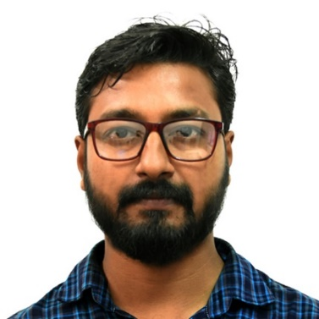

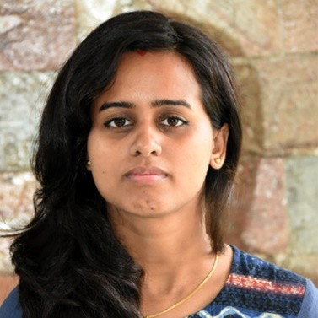

Editing Team
Alphul Gogoi
Ambarish Borkotoky
Bratatee Kashyap
Jitumani Ray
Jyoti Prakash Talukdar
Kuldip Baruah
Rumi Kalita
Rupam Buragohain

Slide 5




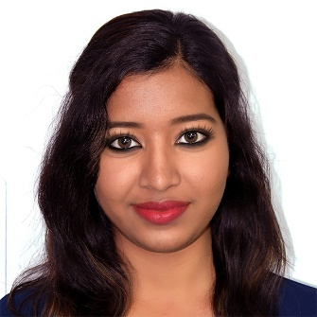

Portal Team
Arnabjyoti Thakuria
Bedanta Kakati
Munmi Dutta
Partha Choudhury
Priya Das
Sunita Das

Slide 6

Graphics Team
Bhupali Deka

Slide 7
Components of NPTEL-MOOCs
Course Content: Video Lectures
Assignment: Objective
Subjective
Programming
Final Exam
NPTEL-MOOCs
Discussion Forum
Text-Transcription
Live Interaction Session

Slide 8
Video Lecture Creation Process
Video Recording
Video Editing
Video Review
YouTube Upload

Slide 9
Portal Configuration
Add unit - Module name
Add lesson – Linking the video & self-testing question
Add lecture notes
Add Assignment
Add feedback form
Add announcement
Once the Assignment deadline is over:
Publish Assignment Solution
Evaluate the assignment – For subjective Assignment only

Slide 10
Swayam.gov.in
Remote Sensing for Natural Hazard Studies

Slide 11
Assignment
Objective or Subjective Assignment
8-10 questions per week
Type of Questions for Objective Assignment :
MCQ → Single correct answer
MSQ (Multiple Select Question) → Multiple correct answers
Short Answer: Numerical or Alpha-numerical
Comprehension
Type of Submission for Subjective Assignment: Scan and upload on Google Drive OR Type on the portal
Solutions to assignment
Need to provide a detailed worked out solution
Assignment 0: Based on prerequisite

Slide 12
MCQ/MSQ(multiple choice/select question)
4 options or 2 options (in case of True/False)
correct answer can be 1 or more (in case of MSQ)
For MSQ type, partial marks will be awarded to the correct answers marked in case no wrong option is chosen.

Slide 13
Example
Q.1. Which of the following is not a property of the Hill-climbing algorithm?
A. Terminates when a peak is reached.
B. Does not look ahead of the immediate neighbors of the current state.
C. Chooses randomly among the set of best successors.
D. Does backtrack.
Q.2. The principles features to achieve a completely intensified process
A. Integration of functions
B. Integration of operations
C. Integration of phenomena
D. None of the above

Slide 14
Short Answer
Numeric Type:
Answer to be entered is numeric (0-9 and decimal point are allowed to be entered)
Answer type: exact value or a range
Range is preferred as opposed to Exact value to allow for approximations
Alphanumeric Type:
Characters on the keyboard except ~ are allowed
The match is an exact match and spelling mistakes or an extra space will also be marked incorrect.
Works best – when one-word input is required
In the question the correct units have to be mentioned for the answer

Slide 15
Example:
Q.3. Consider the binomial asset pricing model with parameters r = 0:4, u = 1:5 and d = 0:7. The the risk-neutral probability measure ep equals:
Ans:- 1
Q.4. Consider a one-year forward contract on an underlying asset whose current price is 120. If the annual risk-free rate (continuously compounded) is 6%, then the forward price equals:
Ans:- 127.4204 - Acceptable range of answer [127.1 - 127.8]

Slide 16
Comprehension
This comprises a problem/passage and based on this there are sub questions
Sub questions can be either MCQ/MSQ or Short Answer

Slide 17
Assignment Weightage
Final marks converted to percentage
For each question, weightage should be 1-3

Slide 18
Assignments Error
Configuring the answer incorrectly
Option can be changed and assignment re-evaluated
All options given are incorrect and none match the actual answer
Question has to be cancelled

Slide 19
Rescoring of Assignments
Summary of the Problem: There are too many errors in the assignments that are being configured on the online courses Portal.
1. Errors take time to handle
For each error: (i) The assignment has to be made private; (ii) solution(s) is/are changed; (iii) re-grading job is started; (iv) announcement is posted.
2. Errors are expensive
Our cost estimate, based on the instances used, is somewhere between Rs. 25,000 to 50,000 per week. Although this amounts to 2 paisa per student per week, this is a cost that we would want to reduce.
3. Errors are a reflection of our quality
When students ask queries about their exams, they say that if there were errors in the assignments, how sure are we that exam questions are error-free.

Slide 20
Statistics on rescoring for the previous semester
Institute | Total Offered Courses | Total Reevaluated Courses | No of Assignments | No of questions
IITG | 81 | 29 | 66 | 94
TYPE OF ERROR | NO OF ERROR
Multiple correct options | 7
No Correct Option | 18
Correct answer configuration error | 45
Erroneous question | 23
0 is given as weightage for the question instead of 1. | 1

Slide 21
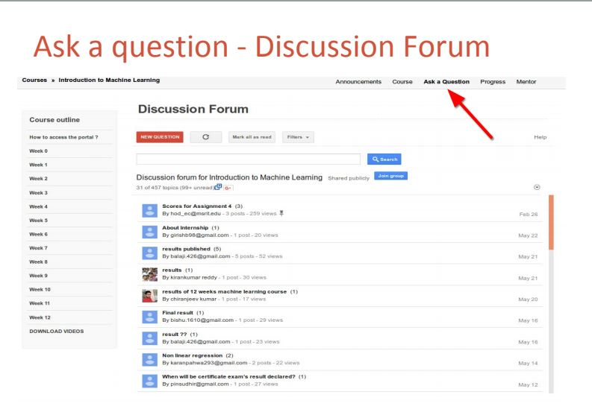
Discussion Forum

Slide 22
Responsibilities
Portal Configuration(in private mode)
Lecture linking
Assignment configuration
Announcement Creation
Lecture Notes Upload
Feedback form linking
Assignment solution upload
Discussion Forum

Slide 23
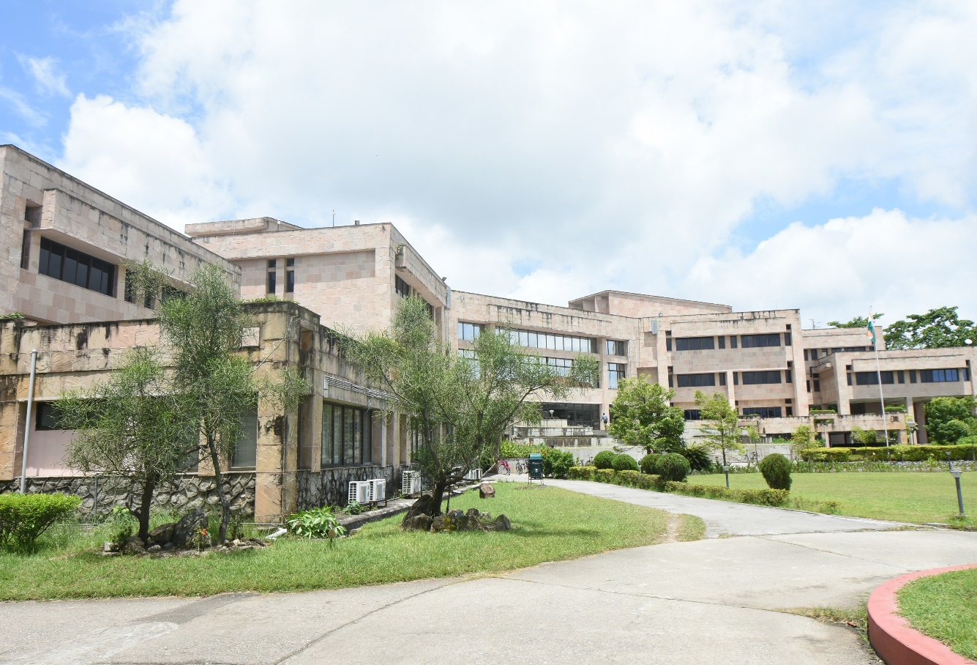
Thank You

